Slide 1



Slide 2


In this lesson, we'll be...
thinking about how exercise helps us to stay healthy.
learning about lungs and what they do.
learning about ways to look after our lungs.
using special vocabulary.
Keywords
heart
muscles
bones
blood
brain
lungs
ribcage
breathing
pollution
organs
mucus
inhale and exhale
air
oxygen
carbon dioxide
health and wellbeing
exercise

Slide 3




Fit and healthy
What do you think it means to be healthy?
What are some things that people do to look after their health?
What do you do to be healthy?

Slide 4
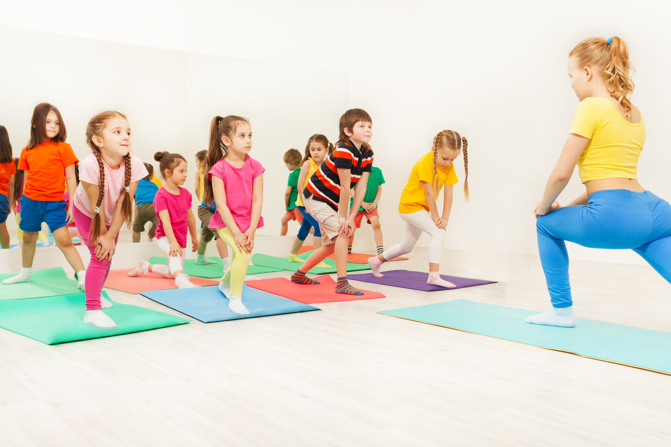
Excellent exercise
One important way to look after our health is to exercise.
Let's play a game of charades!
Think of a way to exercise or a sport then act it out for others to guess. No speaking or sounds are allowed – just actions.

Slide 5

Moving our bodies
Moving our bodies is called physical activity.
Do you know what happens to our bodies when we do physical activity?
Can you name some body parts that get stronger and healthier when we exercise?

Slide 6
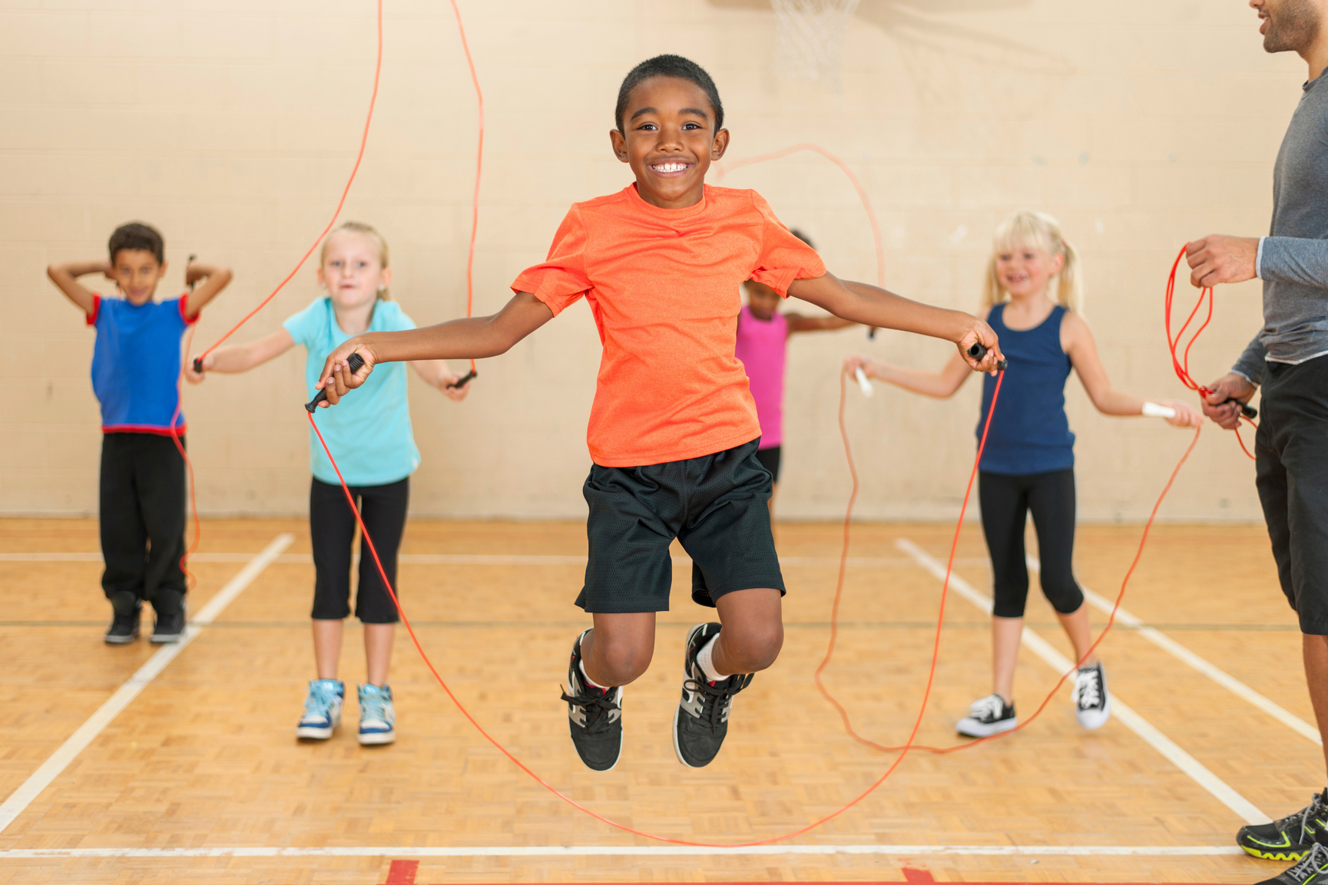
Healthy on the inside
Physical activity helps our bones and muscles to get stronger.
When we exercise, our heart beats faster as it works hard to pump blood all around our bodies – to our muscles and our brain.
Our breathing also gets quicker when we exercise so that we can take in more oxygen. This means our lungs are working harder, which makes them stronger.

Slide 7
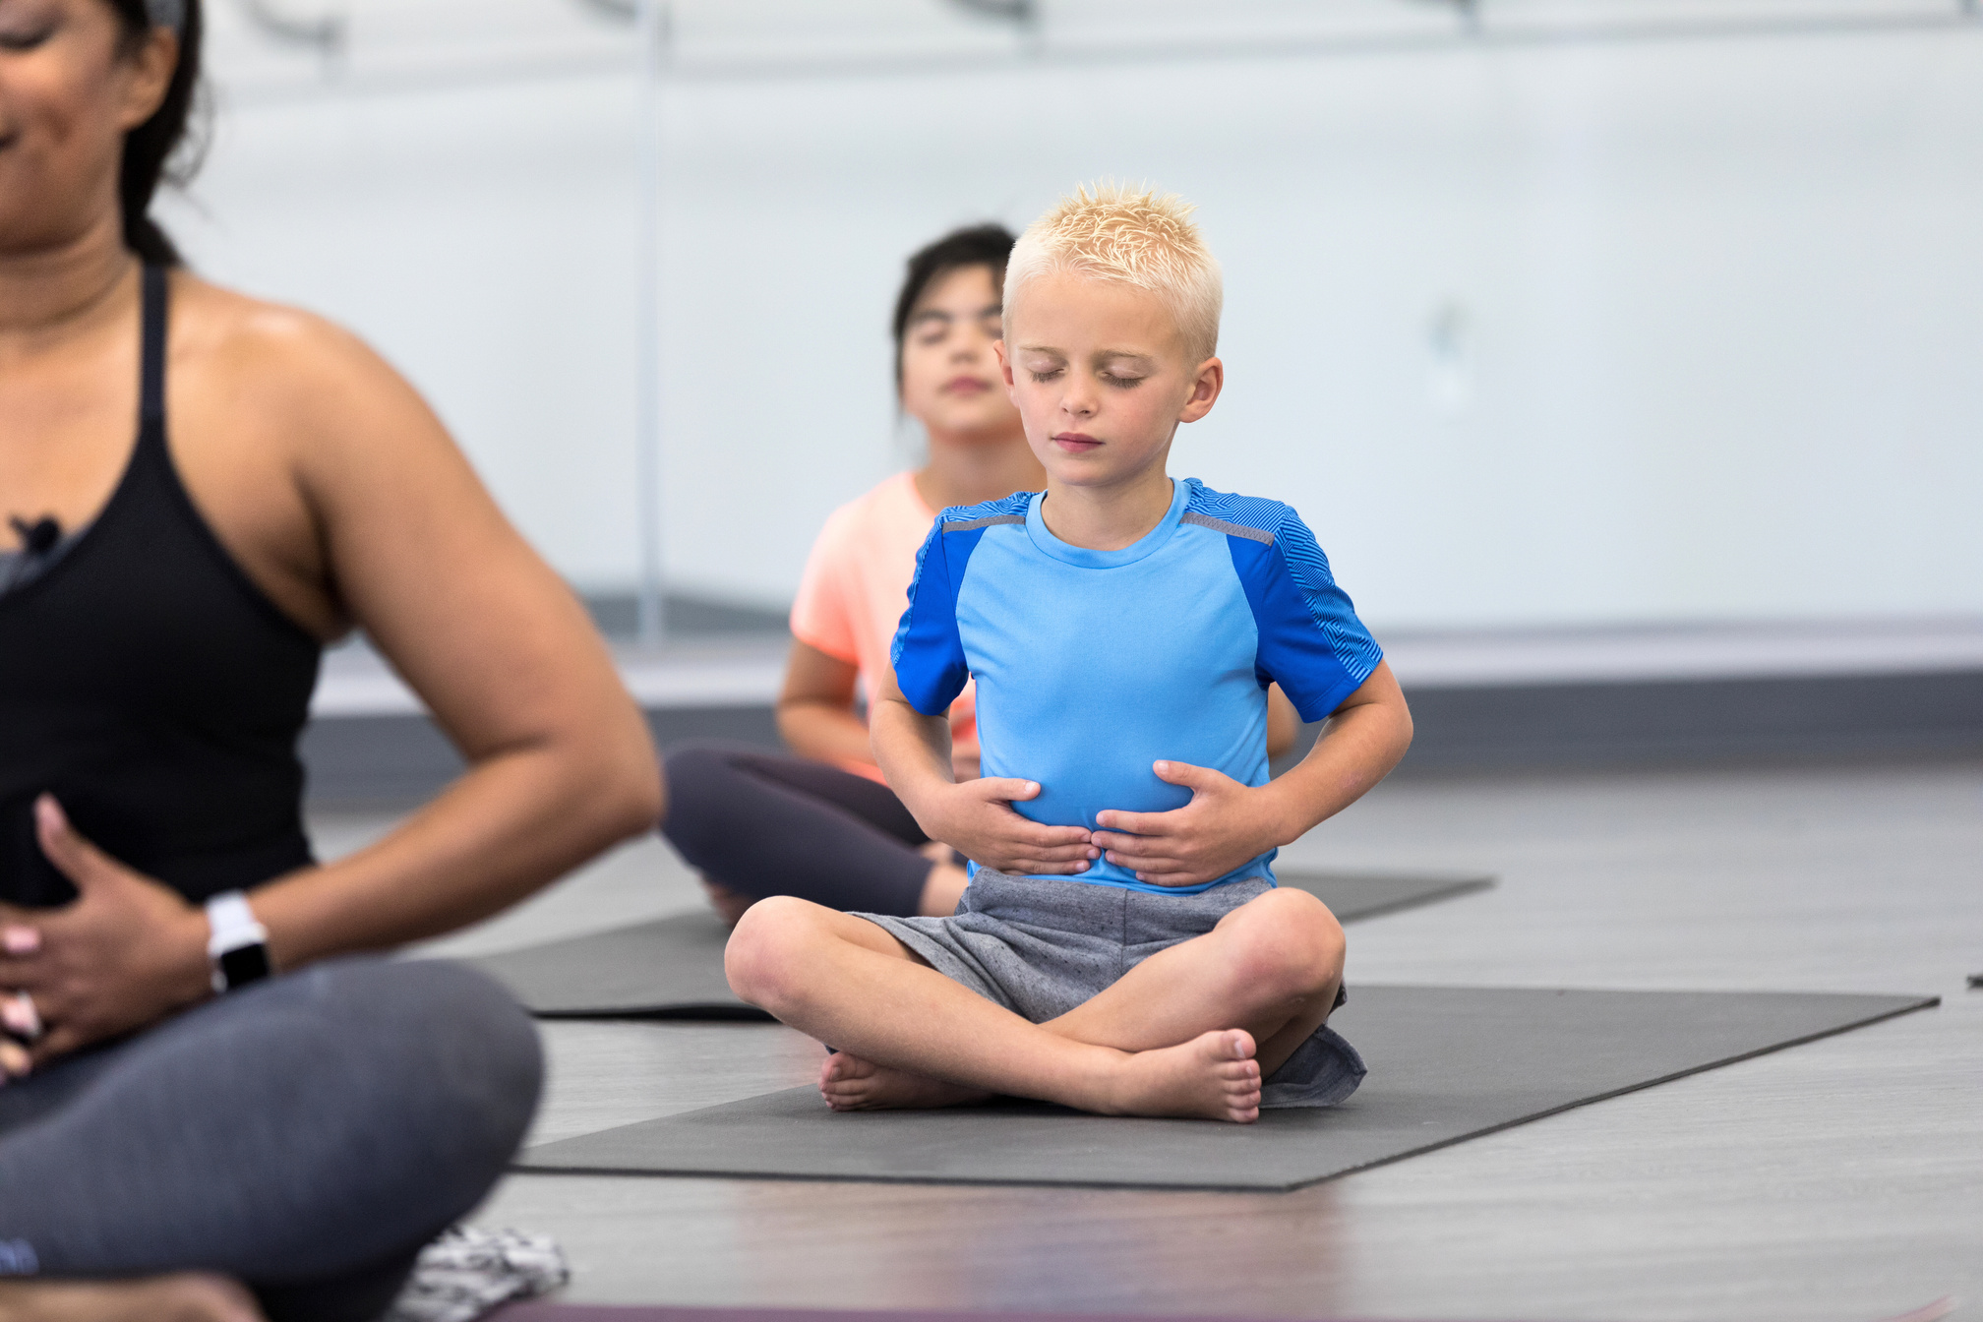
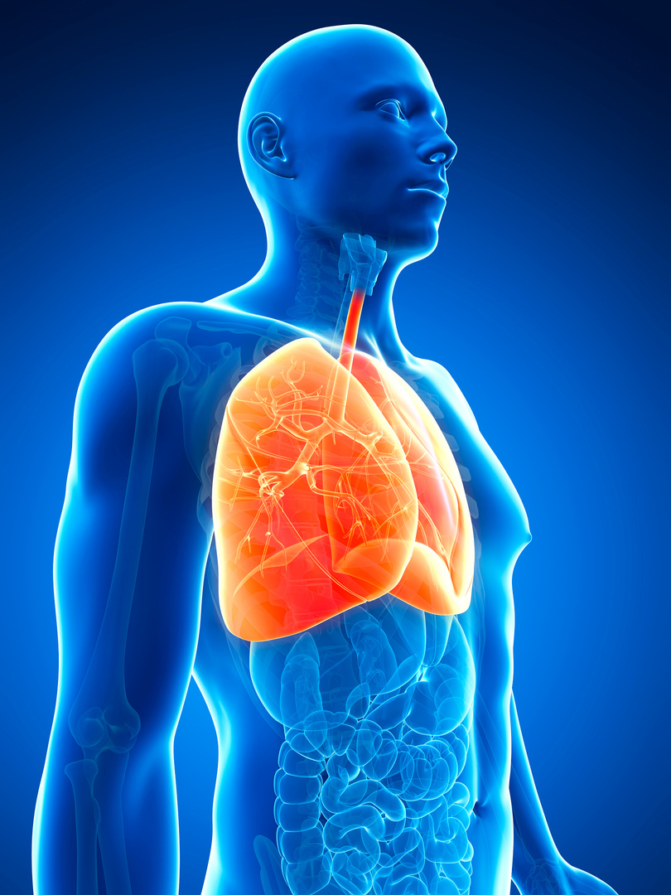
Let's learn about lungs
Take a breath in now, then breathe out slowly. This is called inhaling and exhaling.
Air travels from our nose and mouth through tubes to our two lungs. We inhale oxygen and exhale carbon dioxide.
The lungs are in our chest and are protected by our ribcage.
Can you feel your ribcage?

Slide 8
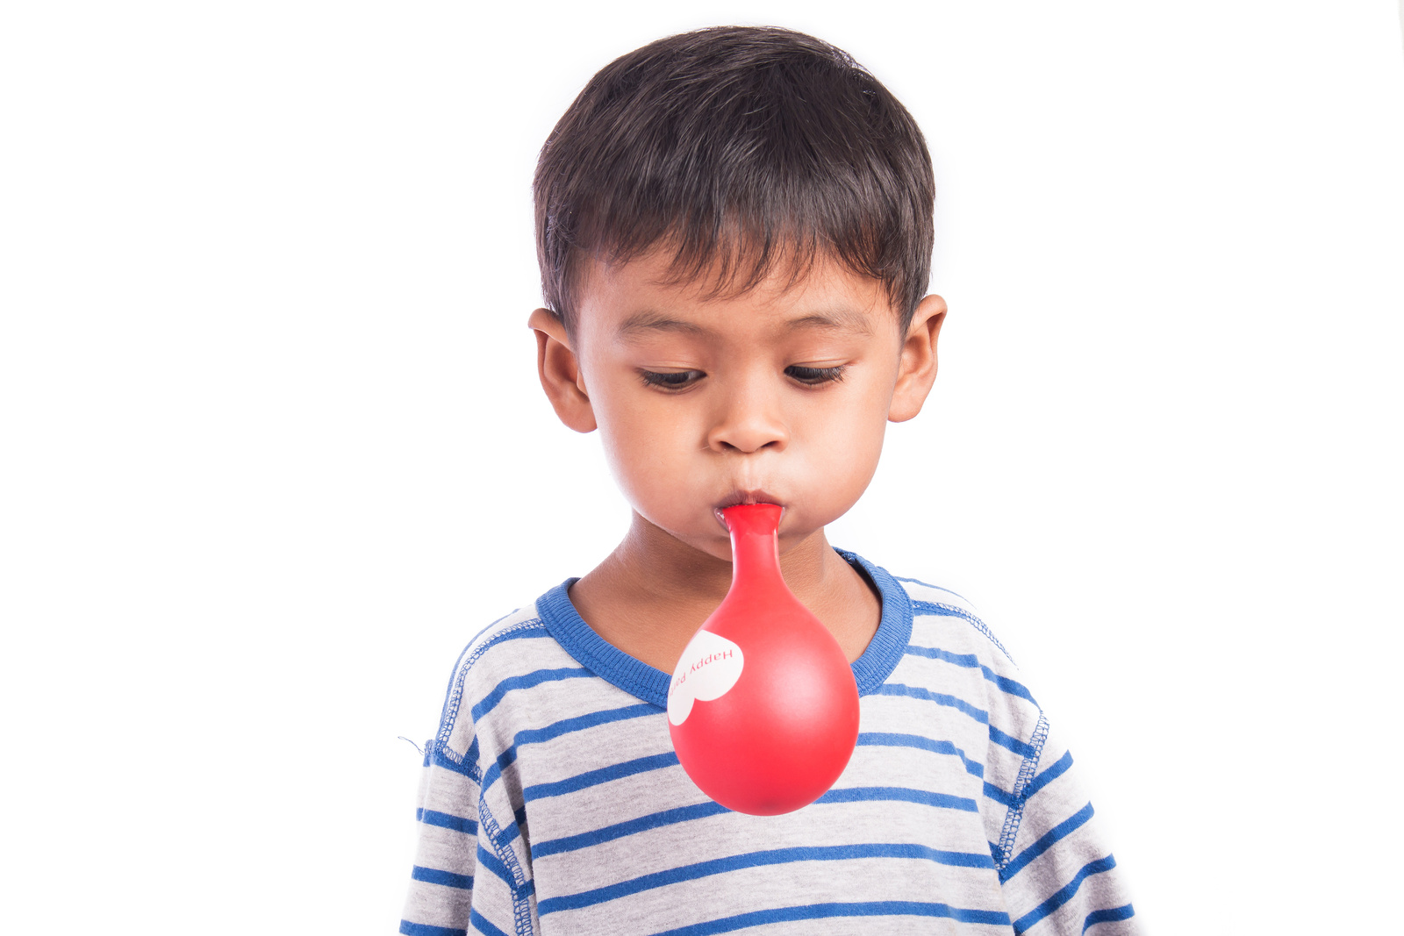


Helpful lungs
Our lungs are very important organs.
Like balloons, they expand as they fill with air to draw in oxygen.
They also trap the things from the air that we don't want in our bodies. We all have a special, sticky mucus inside our lungs to catch things like bacteria and pollution.
The mucus, along with the bacteria and pollution, leaves our bodies when we cough.

Slide 9

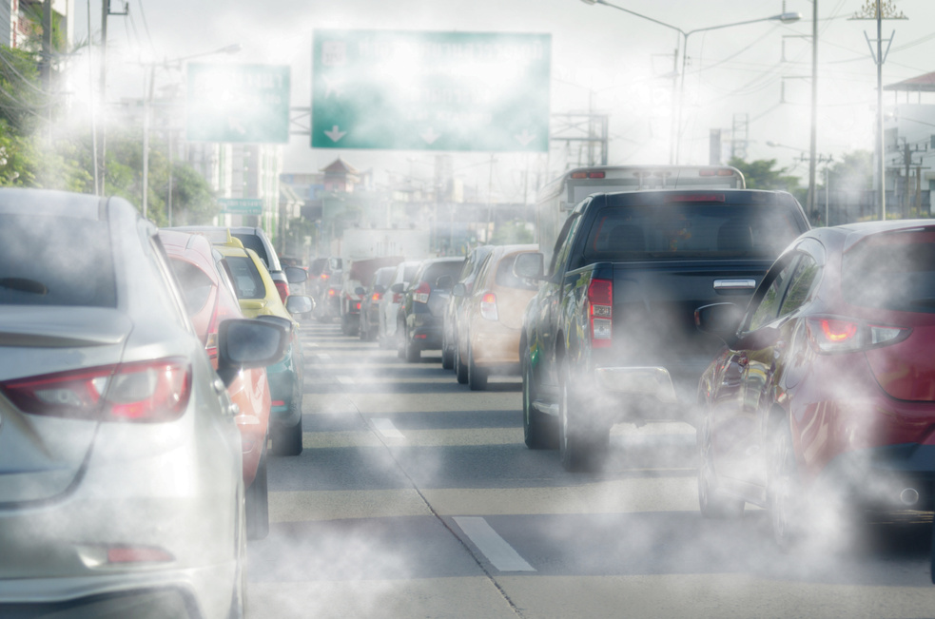
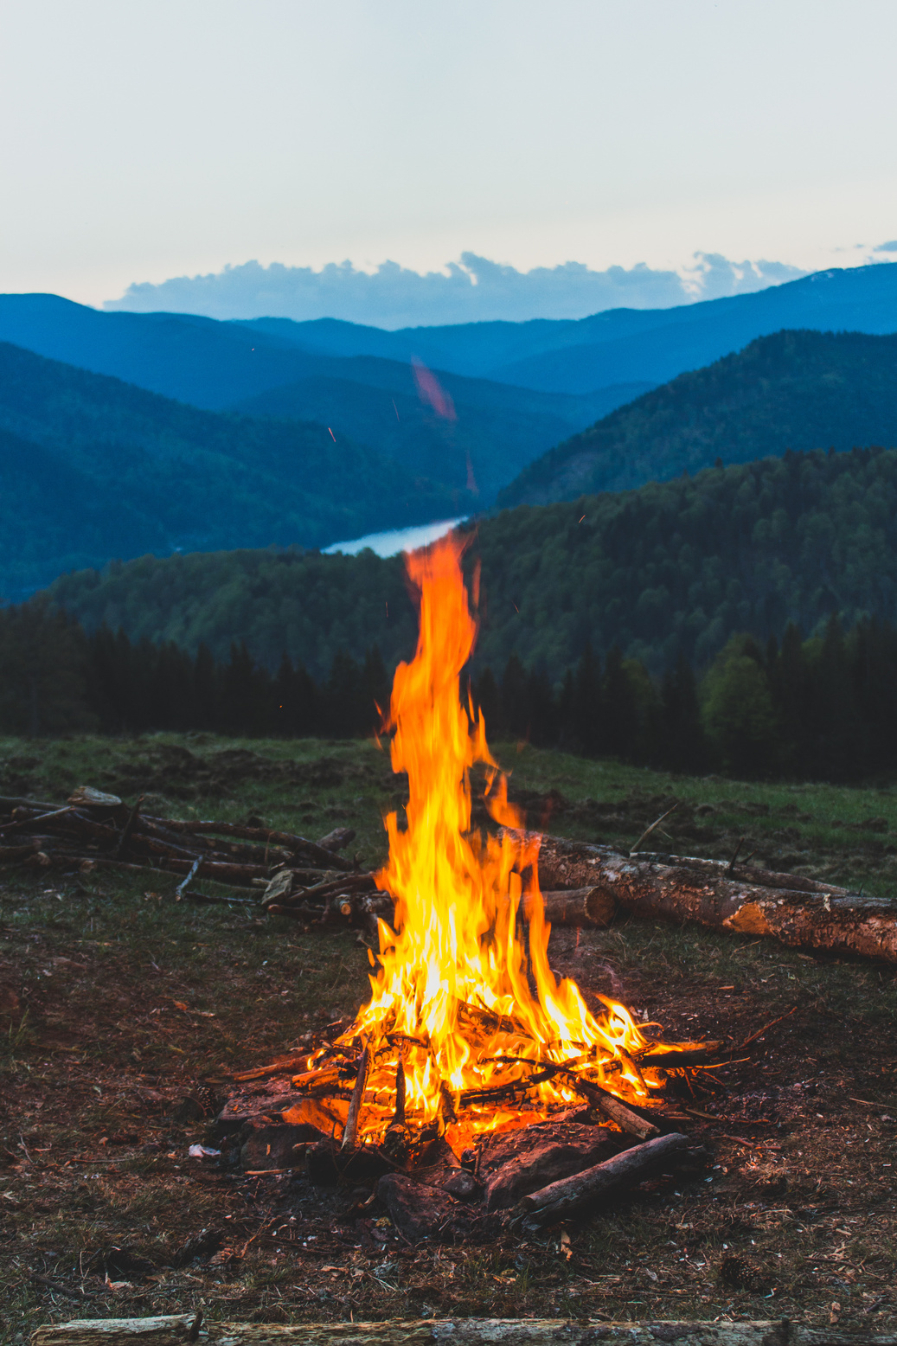
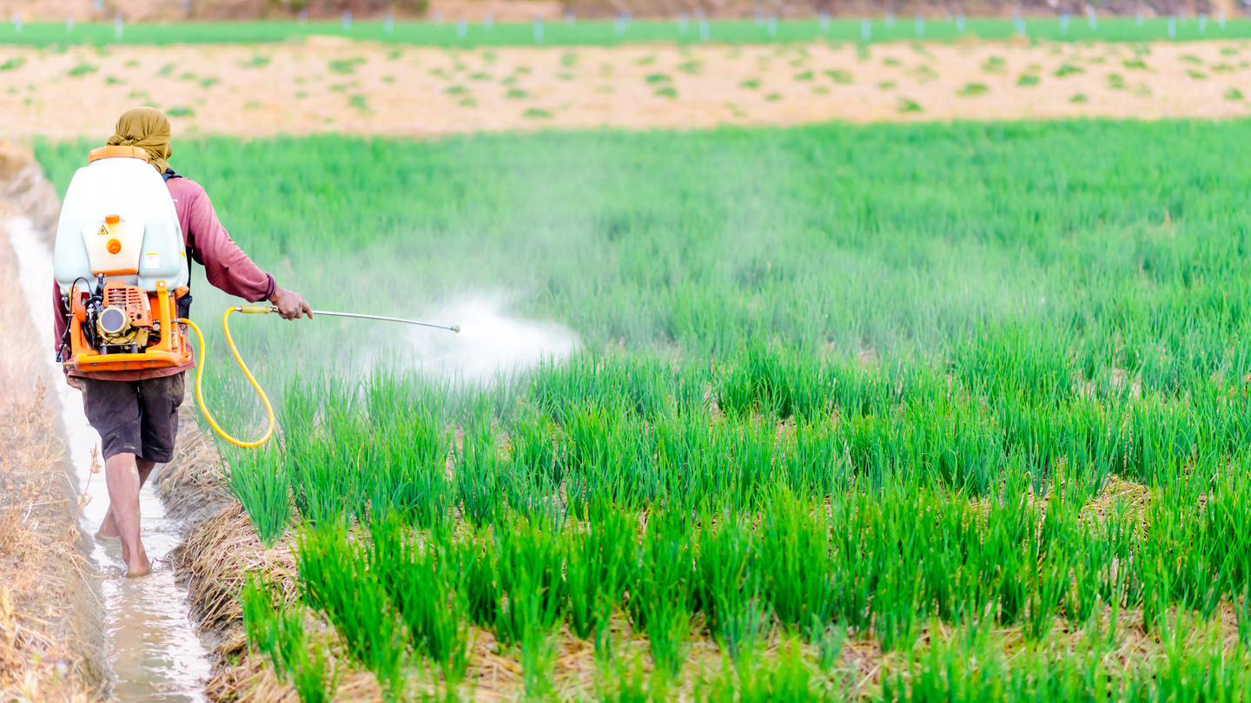
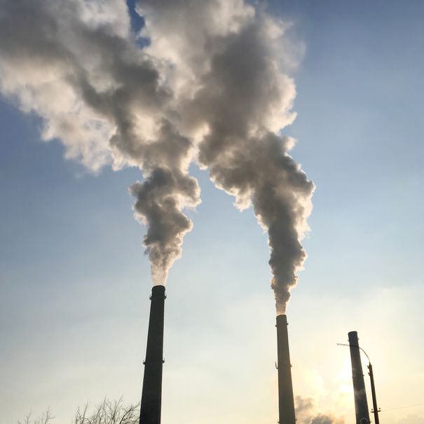
The air we breathe
The air that we breathe in isn't always clean air.
Can you think of anything that might be in the air that we breathe?

Slide 10
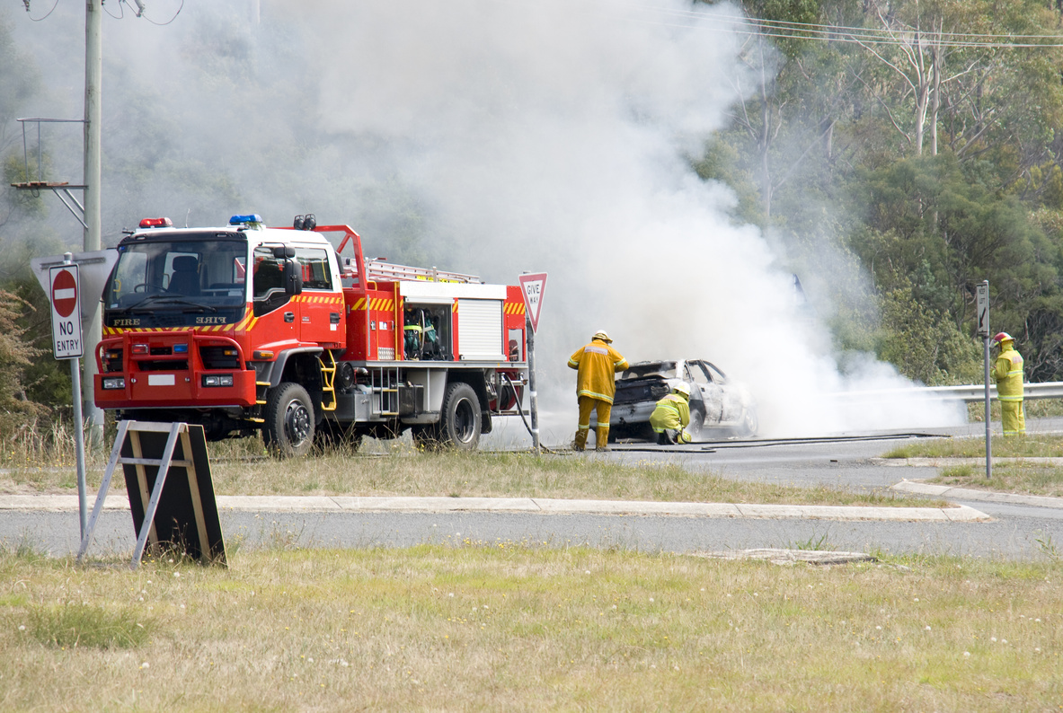
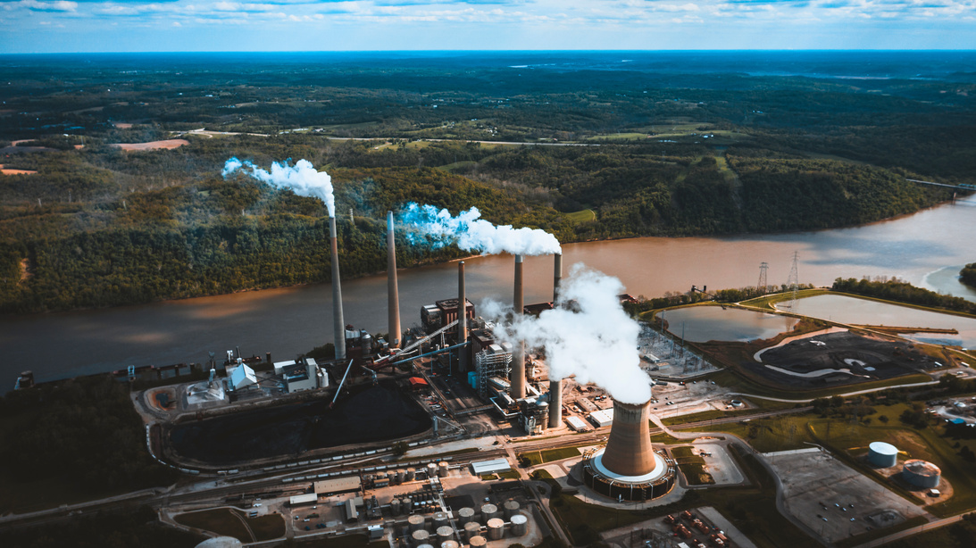
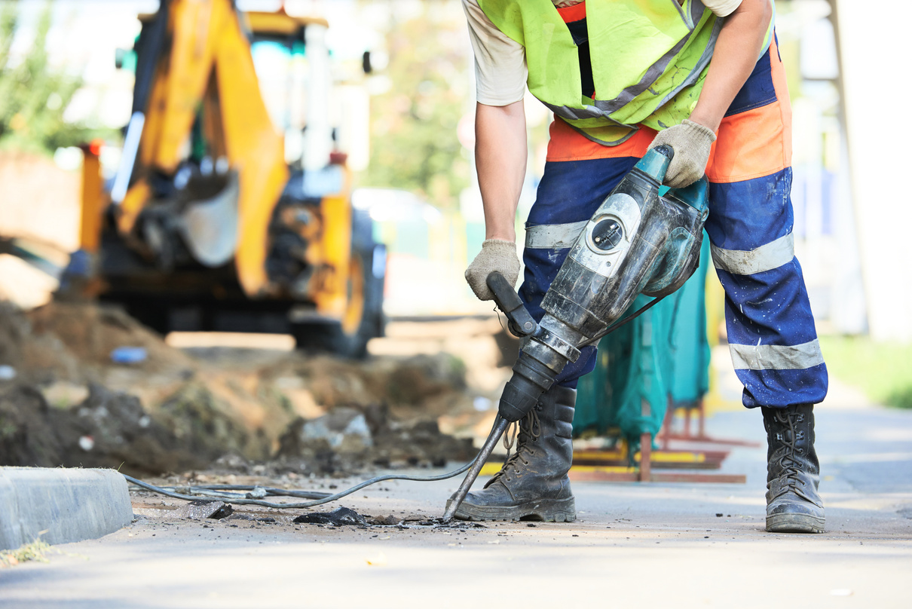
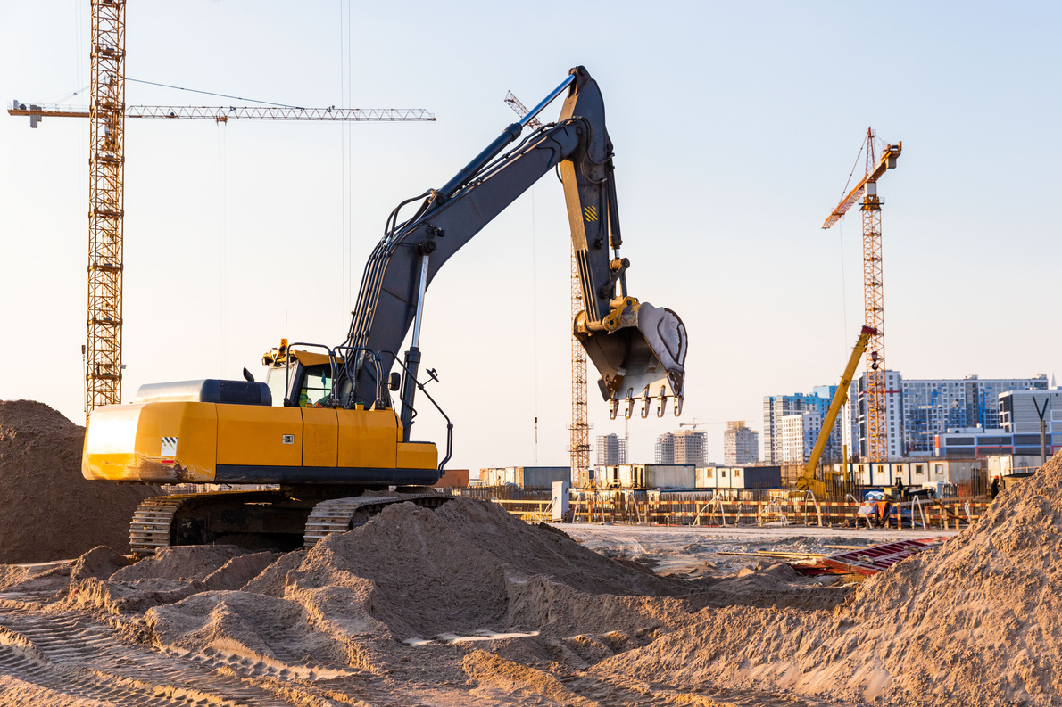
What is air pollution?
Air pollution is when unwanted chemicals, gases and other particles enter the air. They can cause harm to people and animals.
Gases and smoke can come from factories, vehicles and fires.
Farmers spray crops with pesticides to stop insects from eating them.
Dust and dirt gets into the air from lots of places, like roads and building sites.

Slide 11
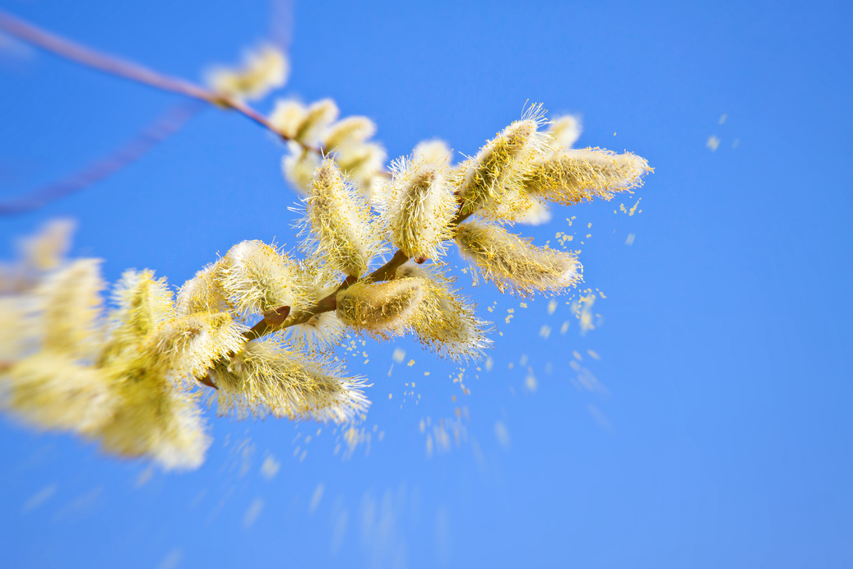
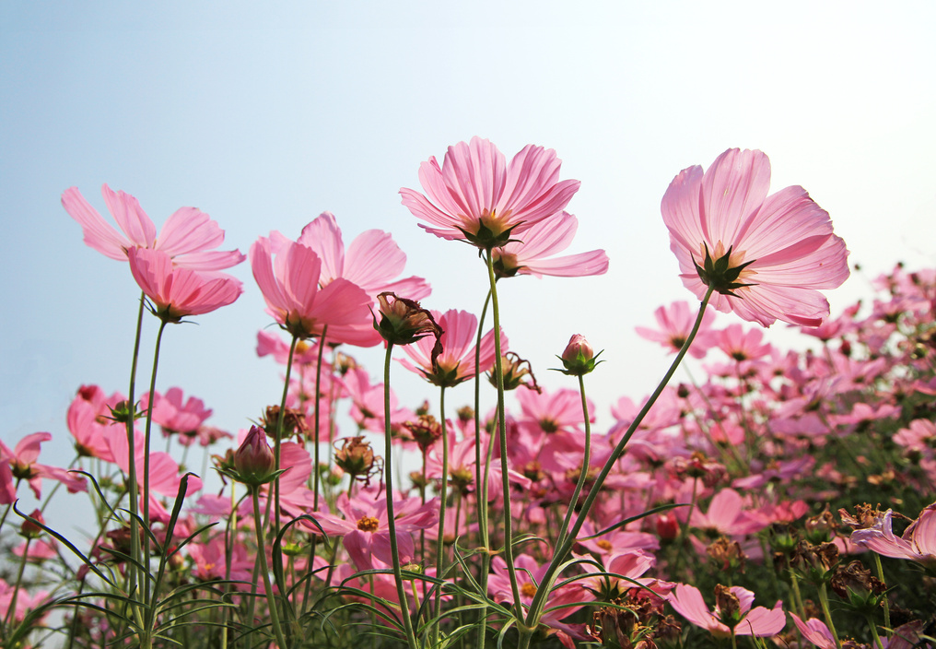

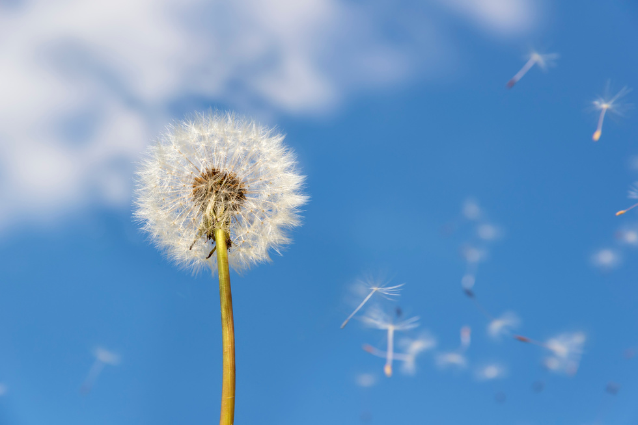
What else is in the air?
There are other things in the air that might be a problem for some people.
There can be a lot of pollen from plants in the air at certain times of the year. People who are allergic to pollen may need medication.
Even sea spray, containing lots of sea salt, can contribute to poor air quality in places by the coast.

Slide 12
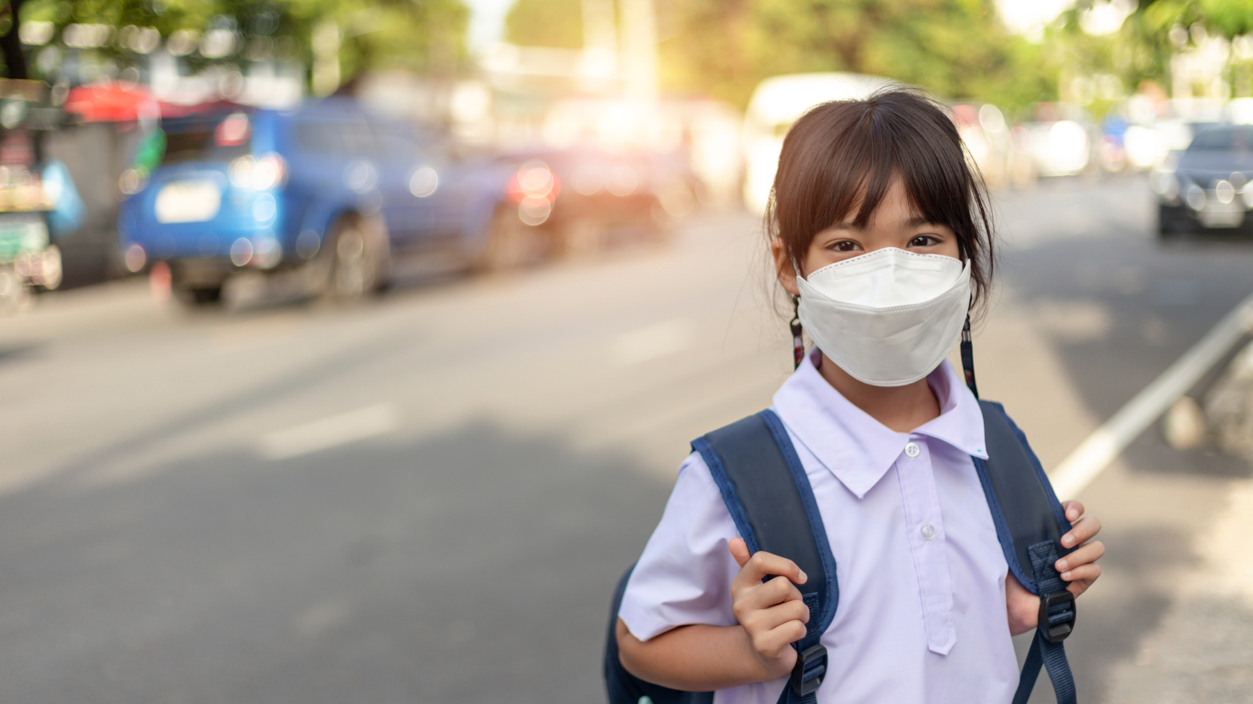
Clean air
To keep our lungs healthy, we can exercise and try to breathe in clean air.
Indoors, we can avoid inhaling cigarette smoke, dust and harmful chemicals, like cleaning products.
Outside, we can avoid breathing in pollutants such as fumes from vehicles and smoke from factories.

Slide 13

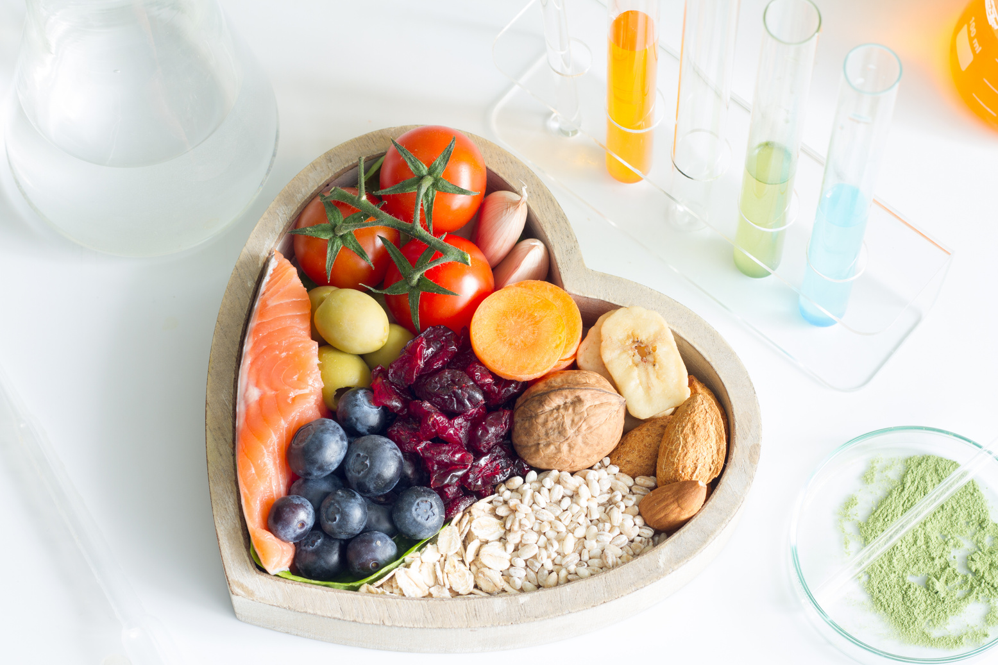
Looking after our lungs
See if you can fill in the blanks...
Exercise helps make our lungs …..................
It is best to breathe in ….................. air and avoid pollution such as …......................
There's another way to look after our lungs – eating healthy food and staying hydrated by drinking plenty of water.

Slide 14
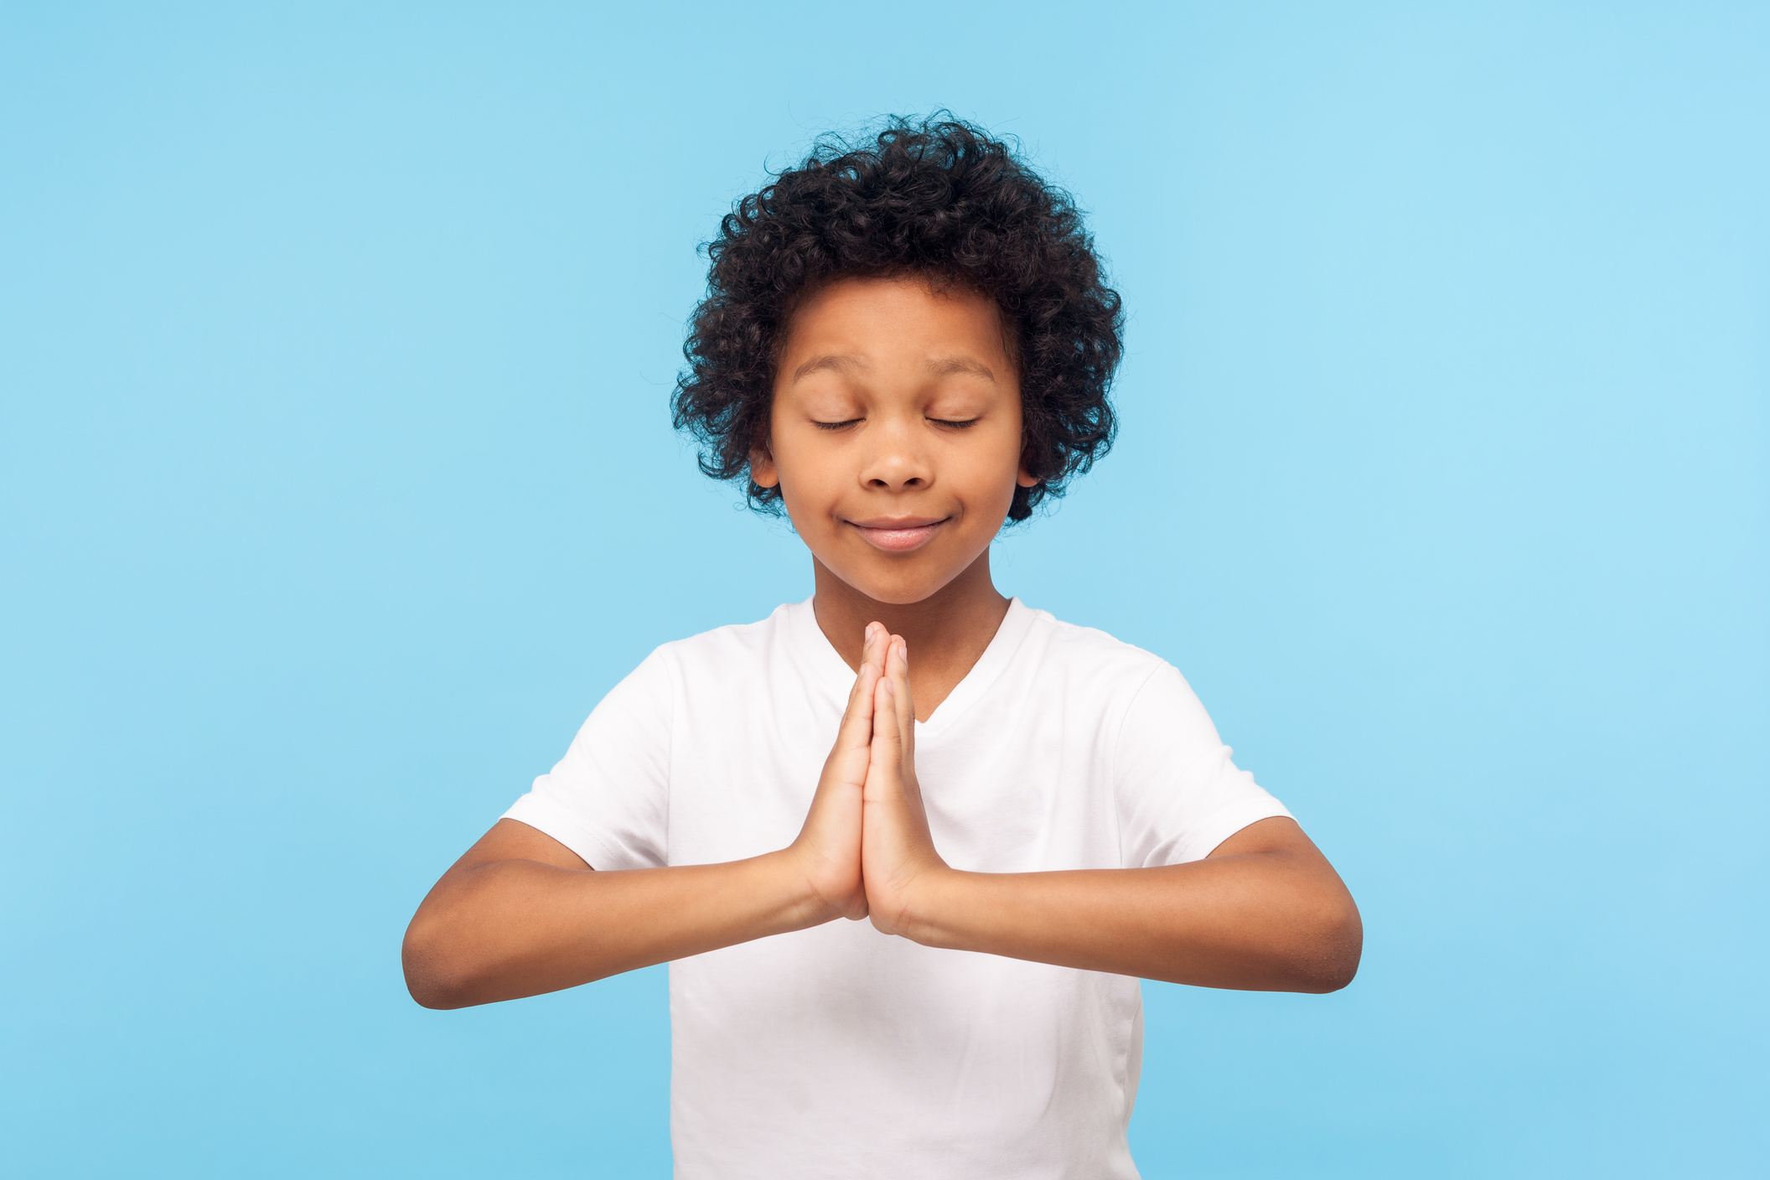
The power of breathing
We breathe all the time without even thinking about it, but it keeps us alive.
Did you know that breathing can also help us to stay calm and feel happy?
Today, we're going to try some special breathing exercises. They're fun and very easy to do. It's important to breathe slowly when we do these exercises.

Slide 15


Balloon breathing
Sit in a comfortable position.
Close your eyes if you'd like to.
Rest your hands on your tummy.
Imagine you have a balloon in your tummy.
As you take a slow, deep breath in, imagine the balloon filling up with air.
Breathe out slowly and imagine the balloon deflating and getting smaller.
Repeat this 5 times, without rushing.

Slide 16


Ocean breathing
Sit in a comfortable position.
Close your eyes if you'd like to.
Imagine you are watching the deep, blue ocean waves.
As you take a slow, deep breath in, imagine the waves rolling up the beach towards you.
As you breathe out slowly, imagine the waves rolling away from you, down the beach.
Repeat this 5 times, without rushing.

Slide 17

Hot chocolate breathing
Sit in a comfortable position.
Close your eyes if you'd like to.
Imagine you are holding a mug of hot chocolate with both your hands.
Breathe the smell of the hot chocolate in as you take a slow, deep breath through your nose.
Then breathe out slowly through your mouth, to cool the hot chocolate down.
Repeat 5 times, without rushing.

Slide 18

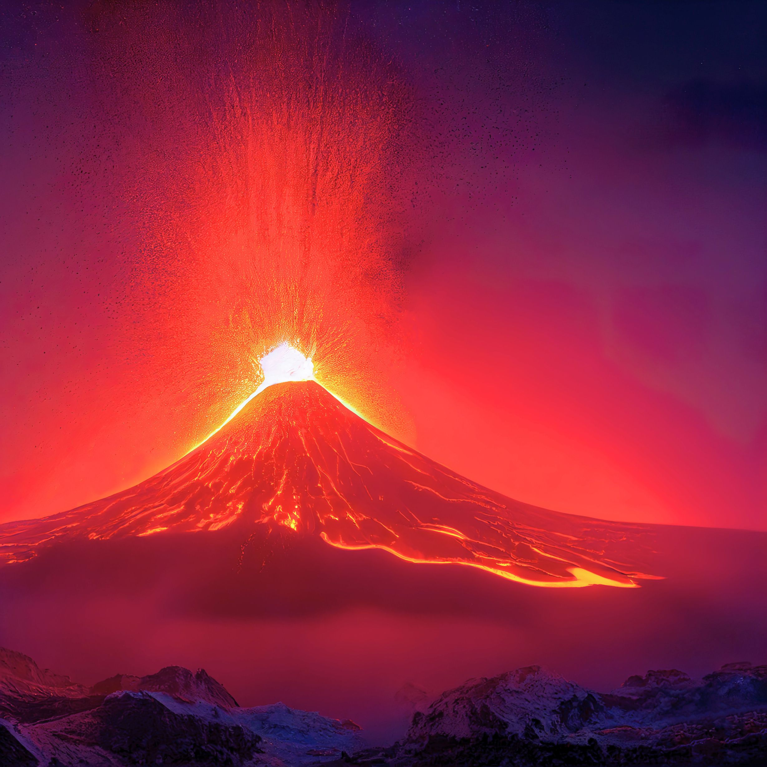
Volcano breathing
Sit in a comfortable position.
Close your eyes if you'd like to.
Place your hands together.
Take a slow, deep breath in, as you reach your hands up over your head to make a volcano shape.
Breathe out slowly and bring your hands down either side, just like flowing lava.
Repeat 5 times, without rushing.

Slide 19
What have we learnt today?
Can you remember some ways to stay healthy?
How does exercise help our bodies?
What can you remember about our lungs?
How can we look after our lungs?
Can you remember a breathing exercise that can help you feel calm and happy?

Slide 20
Breath is an inhalation, an exhalation. Breath is life.
We’re the UK’s lung health charity, fighting for your right to breathe.

